Slide 1
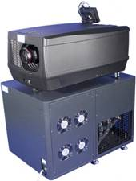
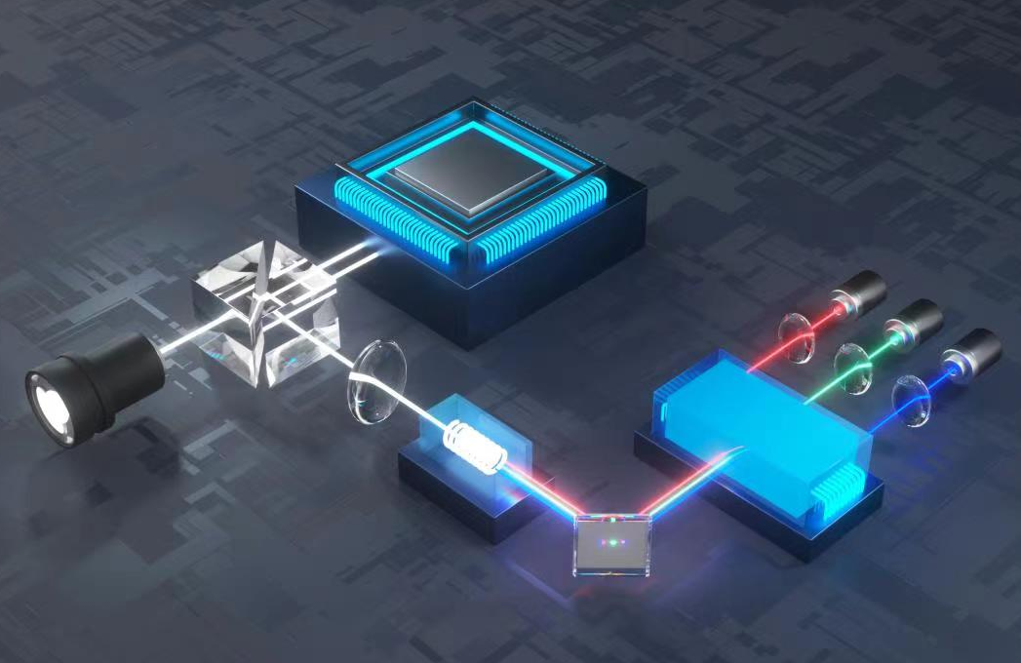
Imaging Chip
Prism
RGB Laser Diodes
Lens
Fiber Rod
Fiber Coupling
Laser Power Supply and Water Cooling System

Slide 2
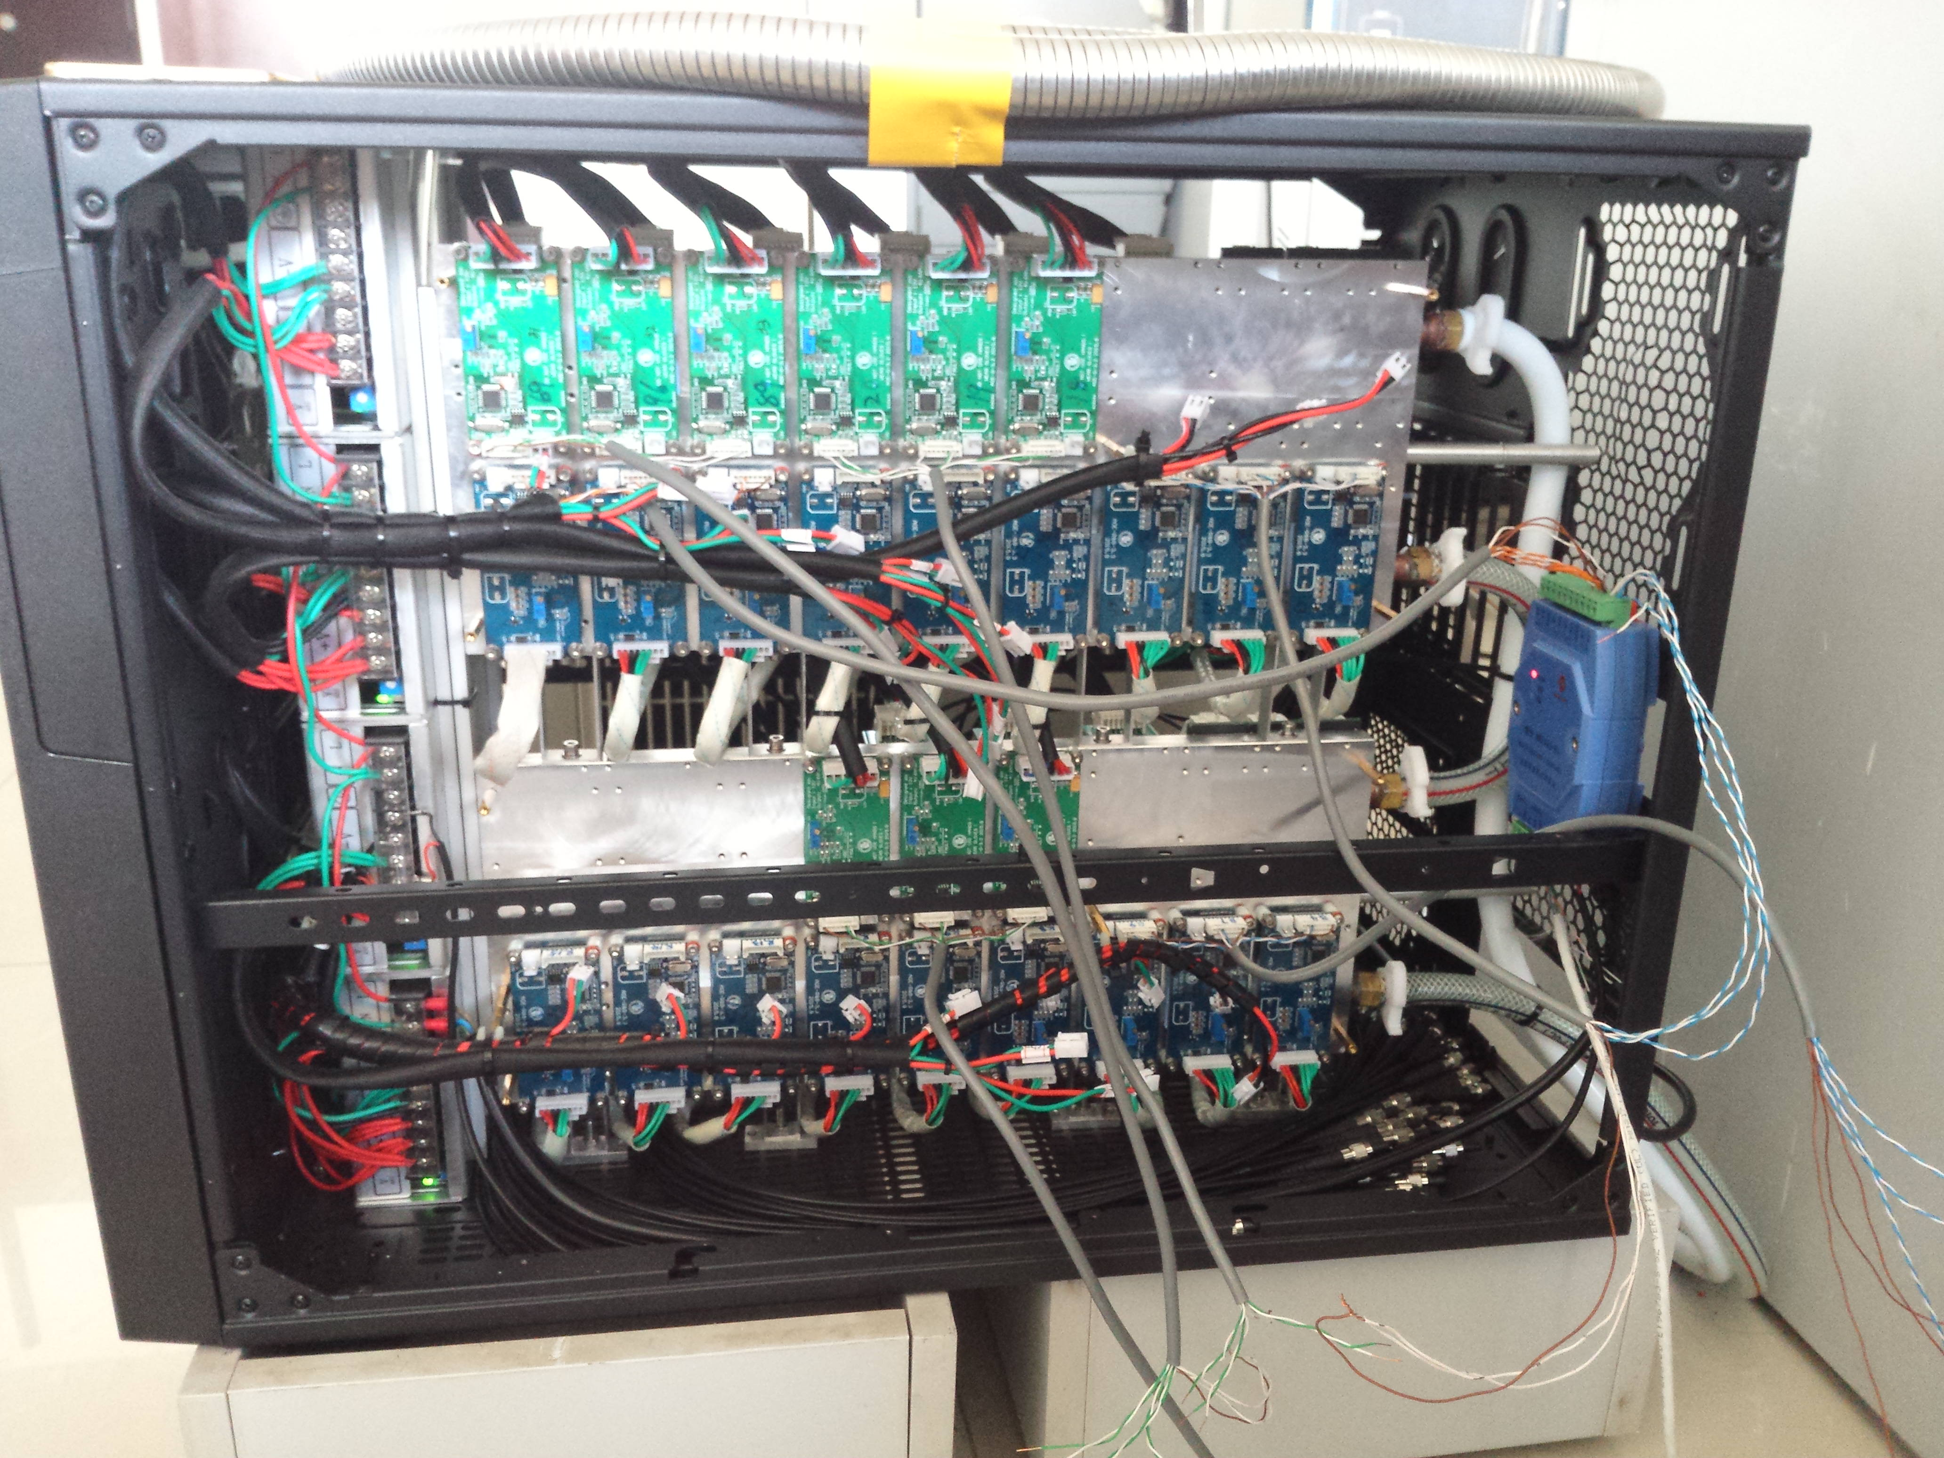
Green LD Driver Array
Water Cooling
Blue LD Drive Array
RS-485 Adapter
Red LD Driver Array

Slide 3
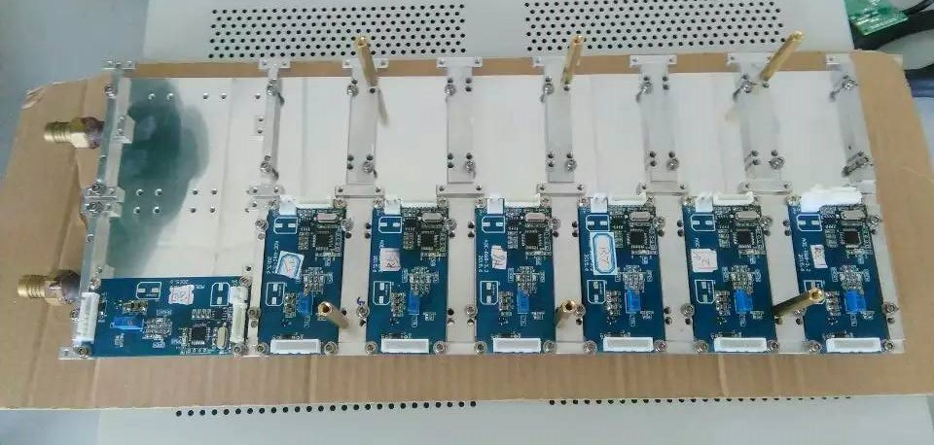
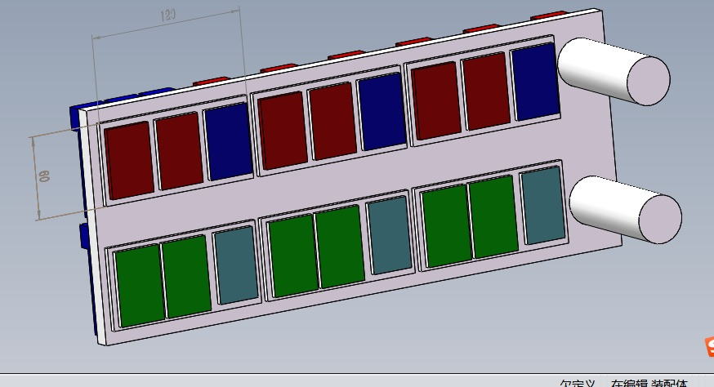
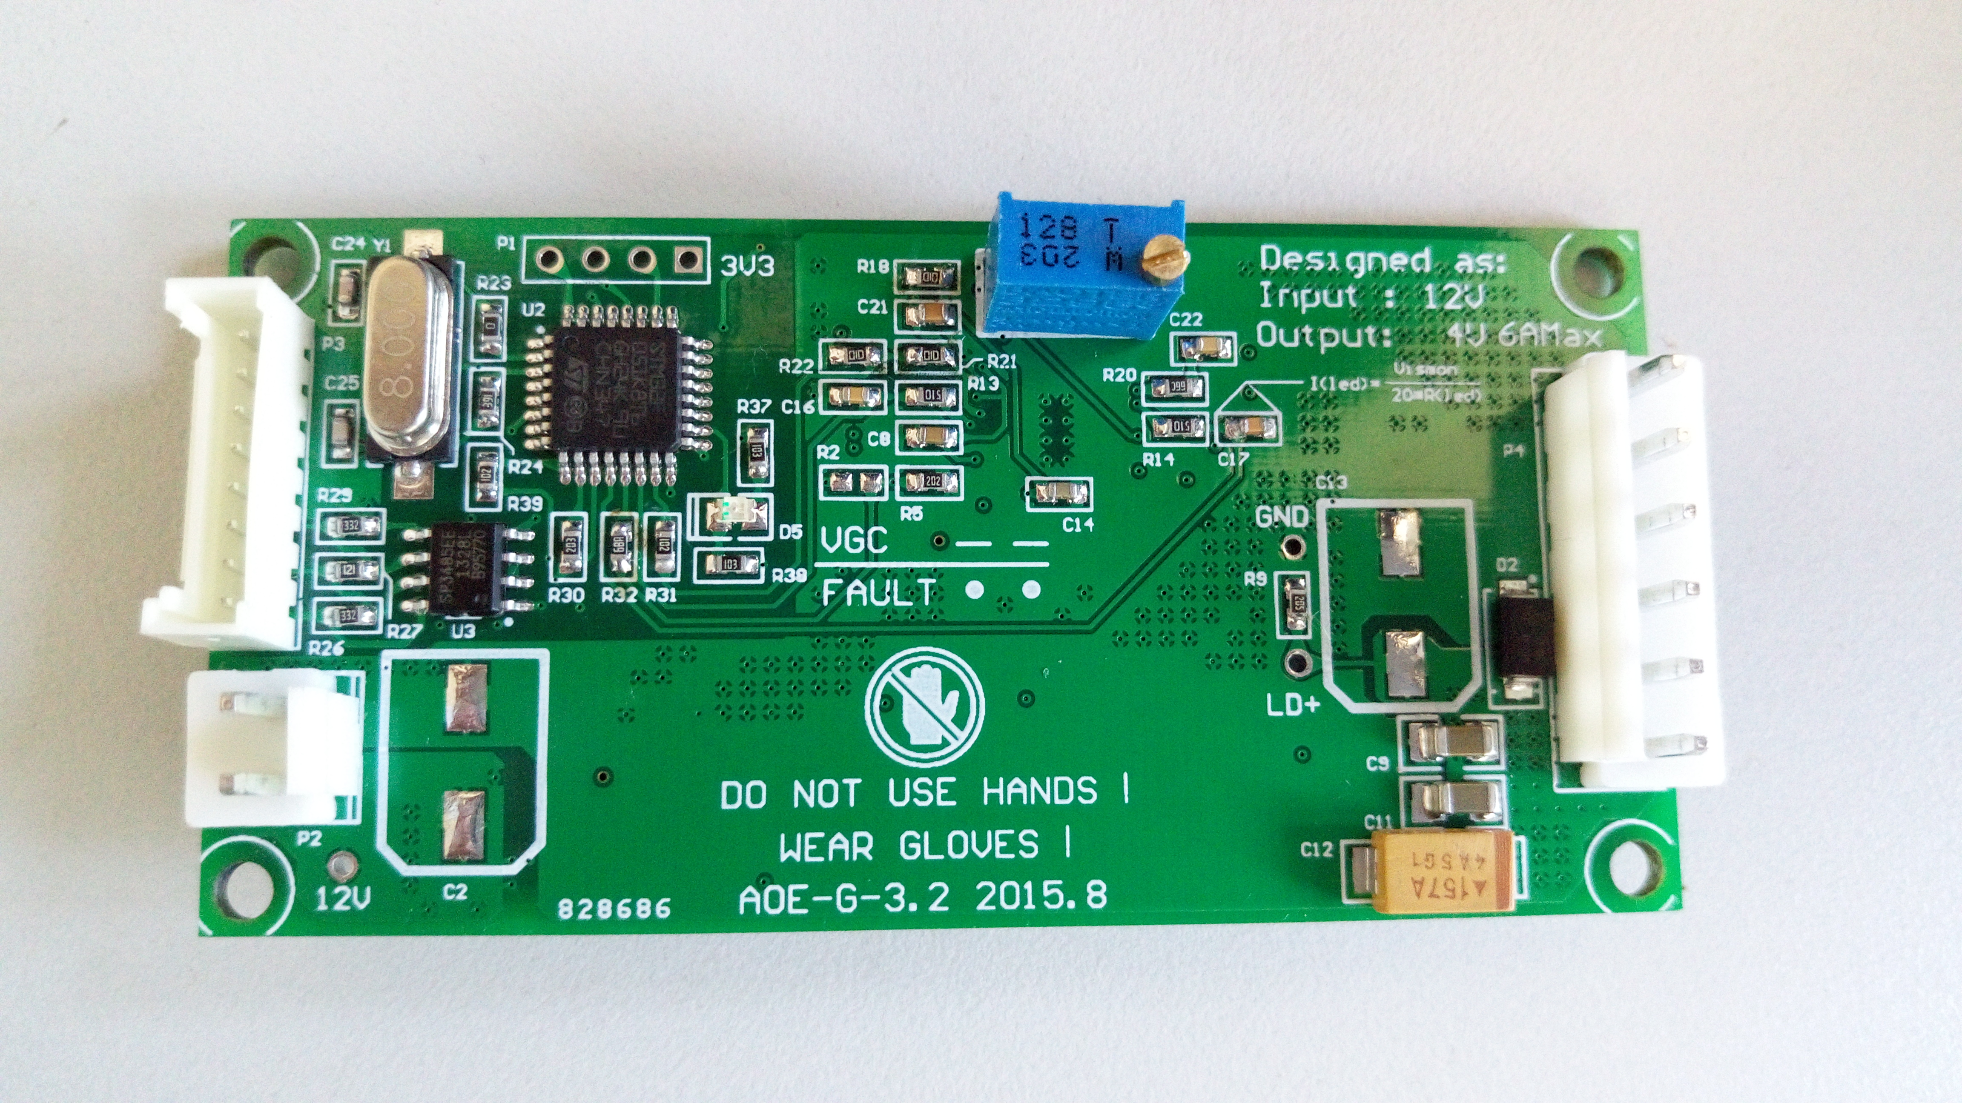
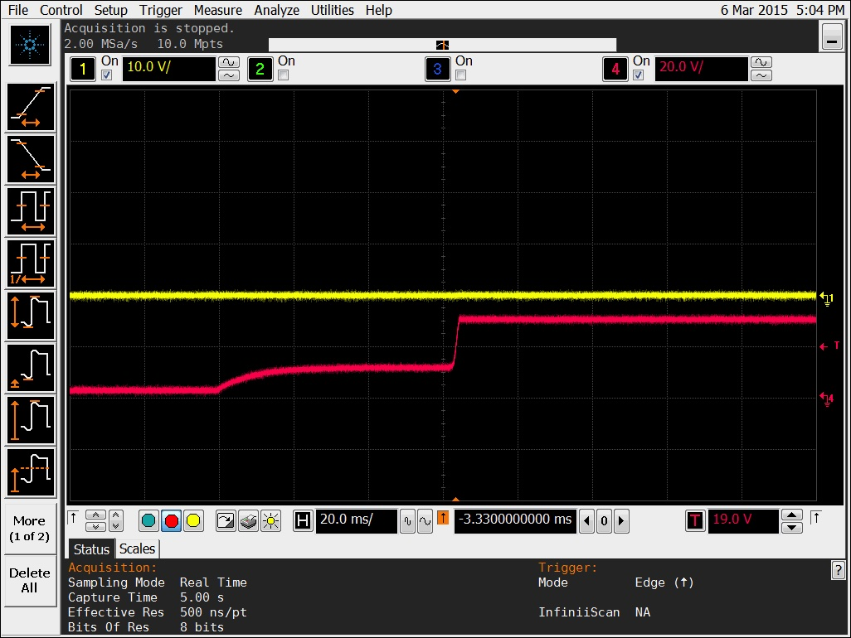
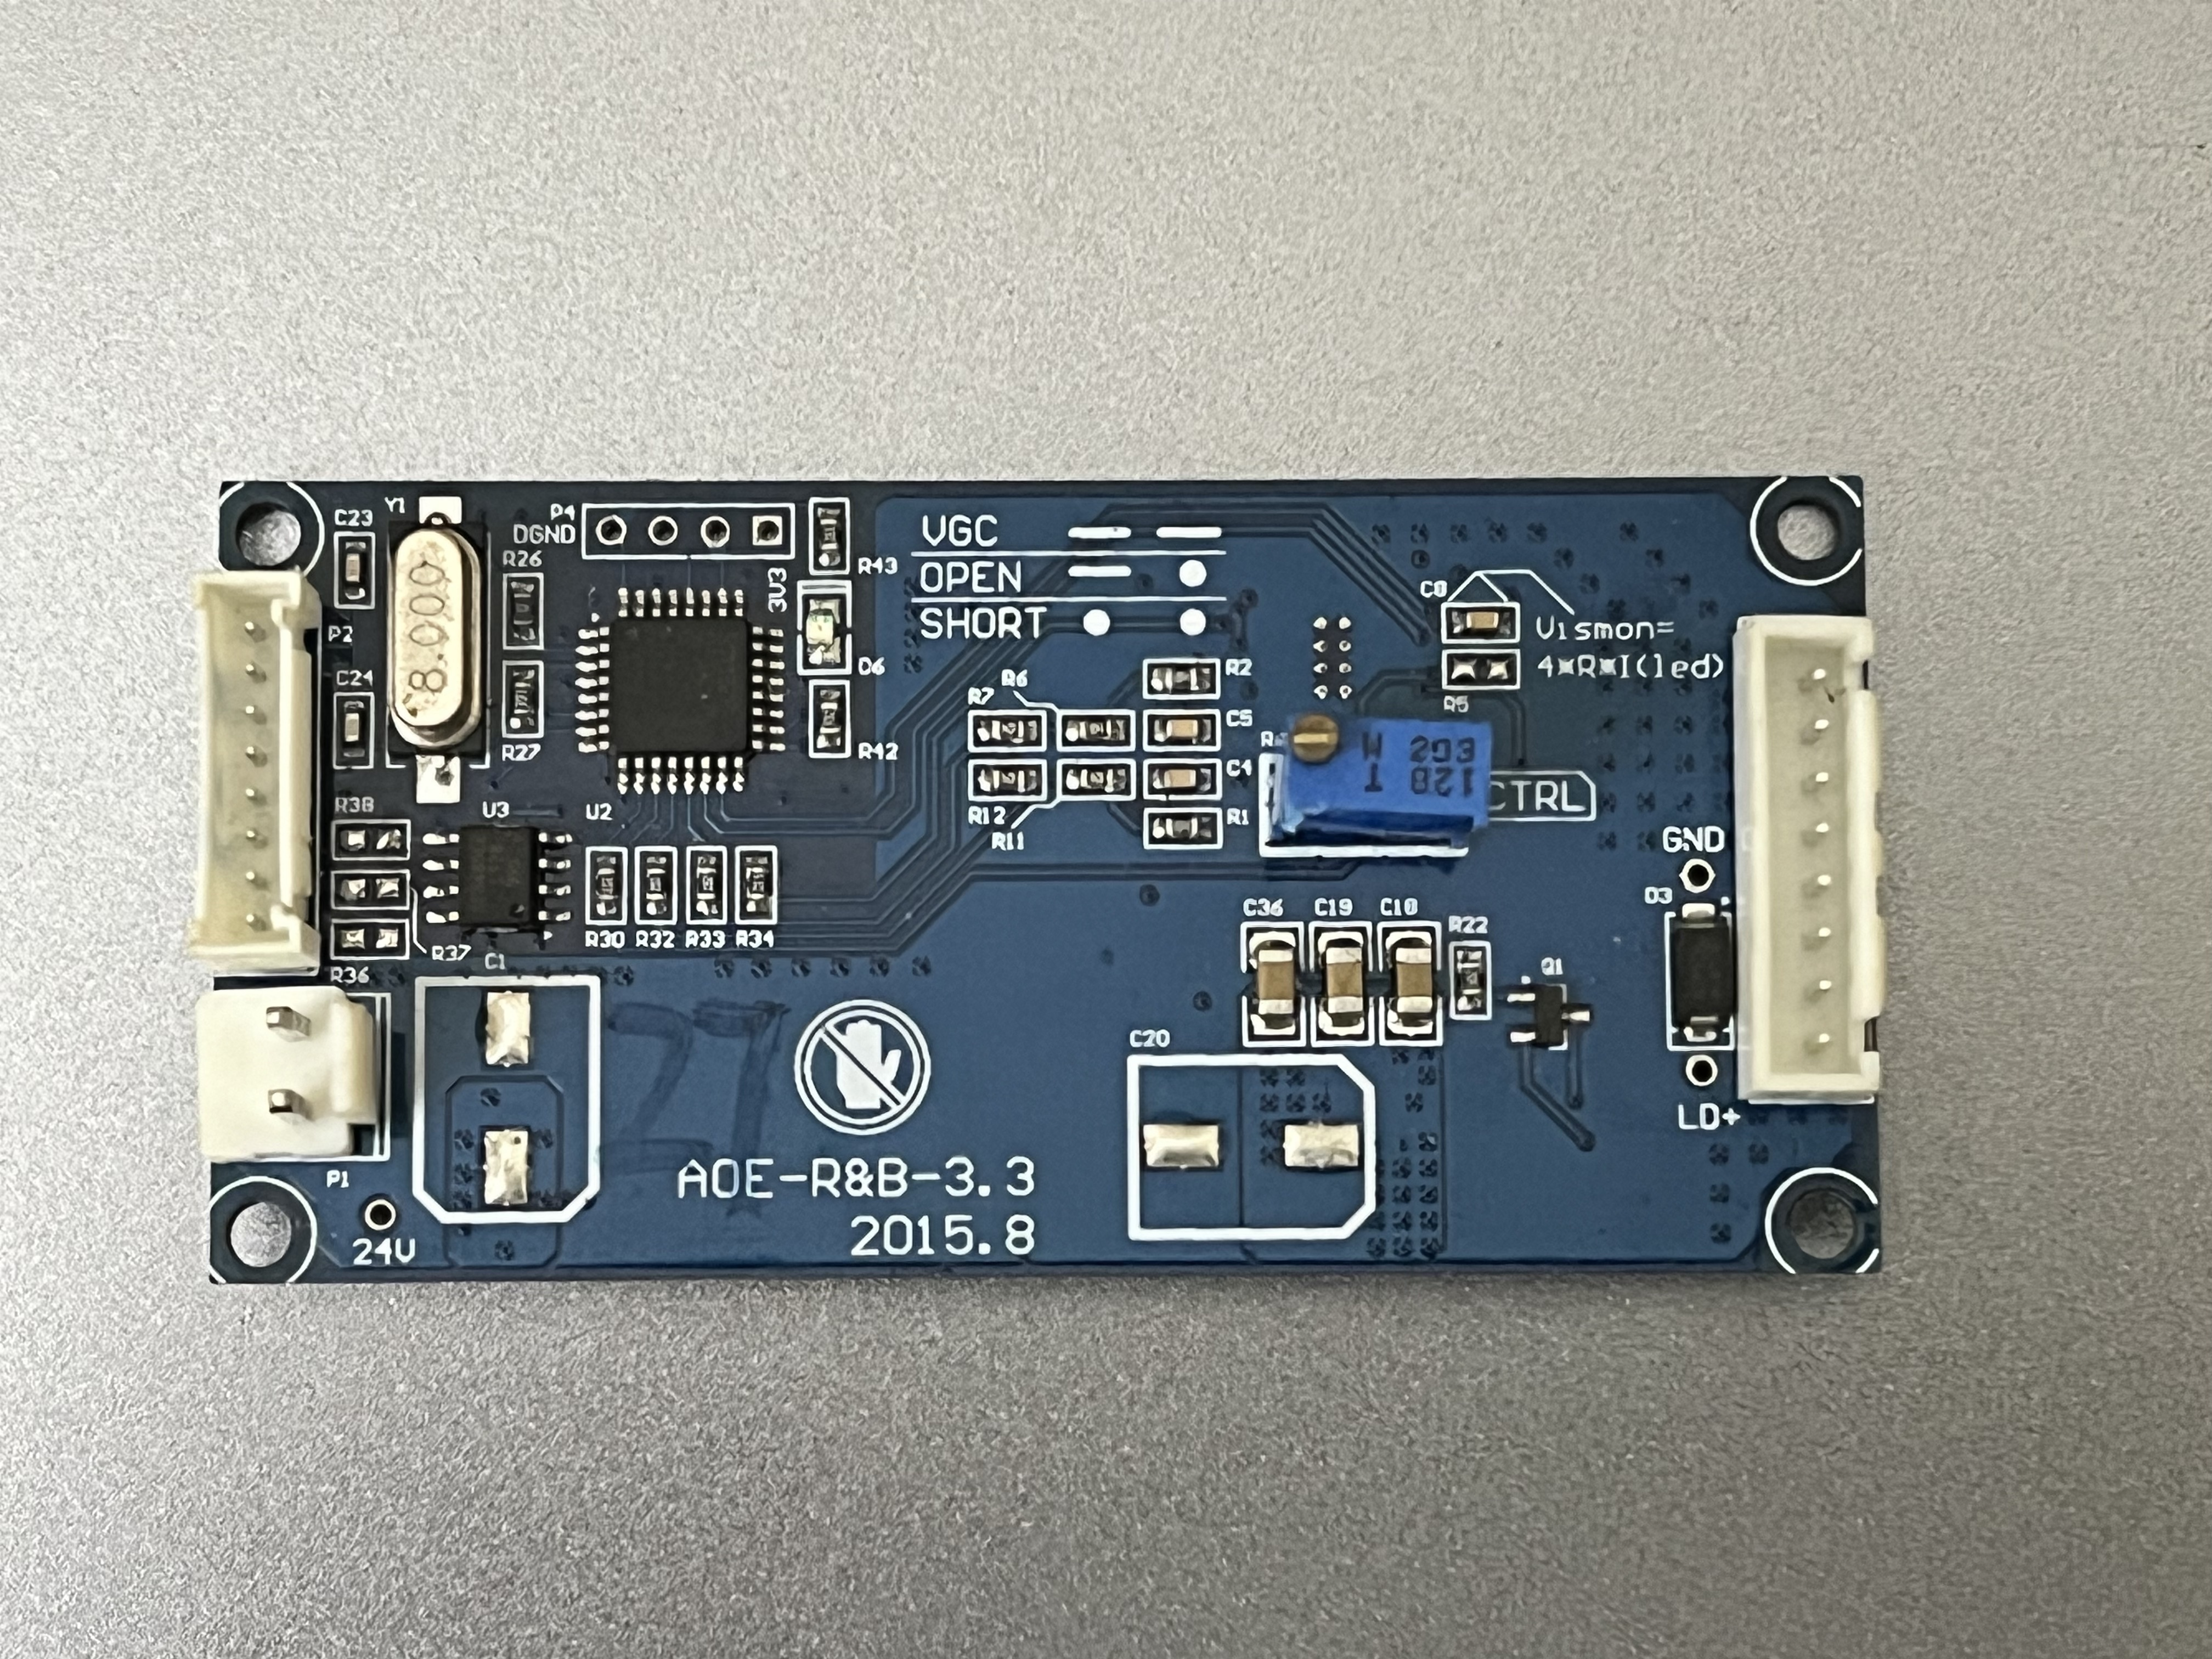
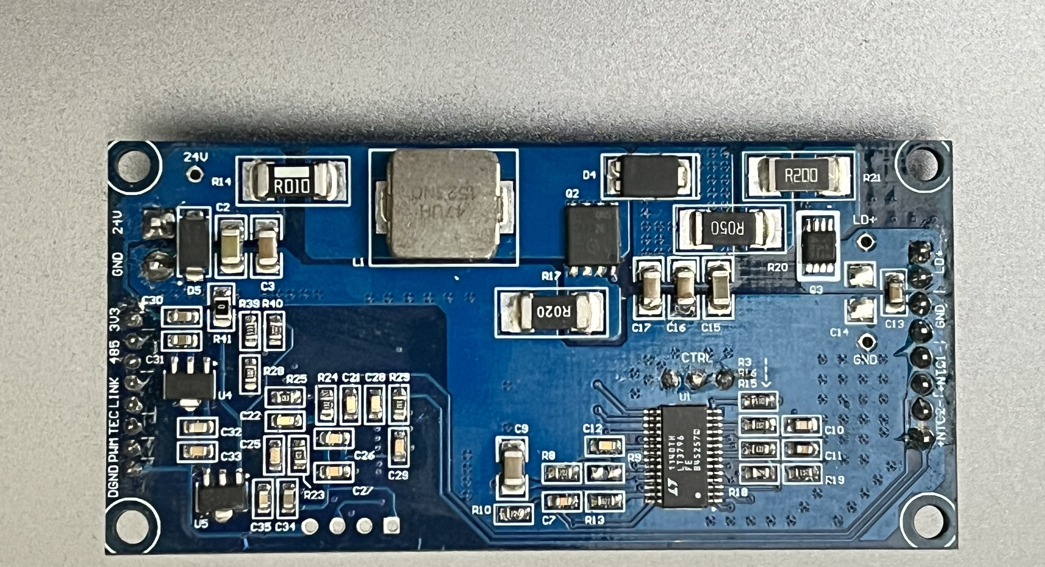
RGB LD Power Supply Module
CAD Drawing of Power Module
Green LD Power PCB Rear View
R&B LD Power PCB Front View
R&B LD Power PCB Rear View
Soft-Start Voltage for Red LD

